Slide 1
Error handling in vb.net
-Ms Rushita Verlekar

Slide 2
Exception Handling
An exception is a problem that arises during the execution of a program. An exception is a response to an exceptional circumstance that arises while a program is running, such as an attempt to divide by zero.
Exceptions provide a way to transfer control from one part of a program to another. VB.Net exception handling is built upon four keywords - Try, Catch, Finally and Throw.

Slide 3
Try-catch-Finally-Throw
try − A Try block identifies a block of code for which particular exceptions will be activated. It's followed by one or more Catch blocks.
Catch − A program catches an exception with an exception handler at the place in a program where you want to handle the problem. The Catch keyword indicates the catching of an exception.
Finally − The Finally block is used to execute a given set of statements, whether an exception is thrown or not thrown. For example, if you open a file, it must be closed whether an exception is raised or not.
Throw − A program throws an exception when a problem shows up. This is done using a Throw keyword.

Slide 4
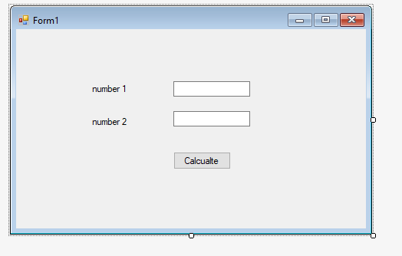
Try divide by zero error
Private Sub Button1_Click(sender As Object, e As EventArgs) Handles Button1.Click
Dim answer, n1, n2 As Integer
Try
n1 = val(TextBox1.Text)
n2 = TextBox2.Text
answer = n1 \ n2
Catch ex As DivideByZeroException
MsgBox(ex.ToString)
Finally
MsgBox(answer)
End Try
End Sub

Slide 5
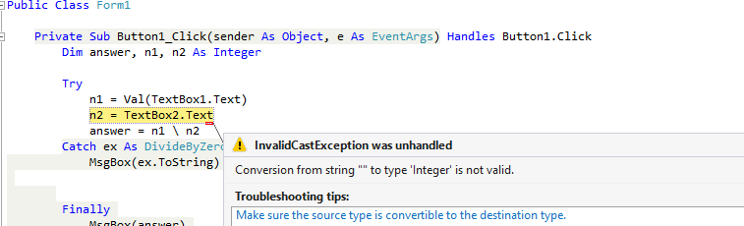
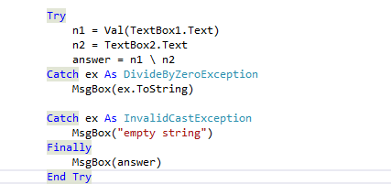
If entered null value then shows the following exception error:
Catch ex As InvalidCastException
MsgBox("empty string")
Add a catch block to the above exception
To handle the error

Slide 6
Custom Error exception
Try
n1 = Val(TextBox1.Text)
n2 = Val(TextBox2.Text)
If (n1 = 0 Or n2 = 0) Then
Throw New ApplicationException(" zero exception")
Else
answer = n1 \ n2
End If
Catch ex As DivideByZeroException
MsgBox(ex.ToString)
Catch ex As InvalidCastException
MsgBox("empty string")
Catch ex As ApplicationException
MsgBox(" change the number to anythg other than zero")
Finally
MsgBox(answer)
End Try
End Sub
Matching catch statement

